Slide 1
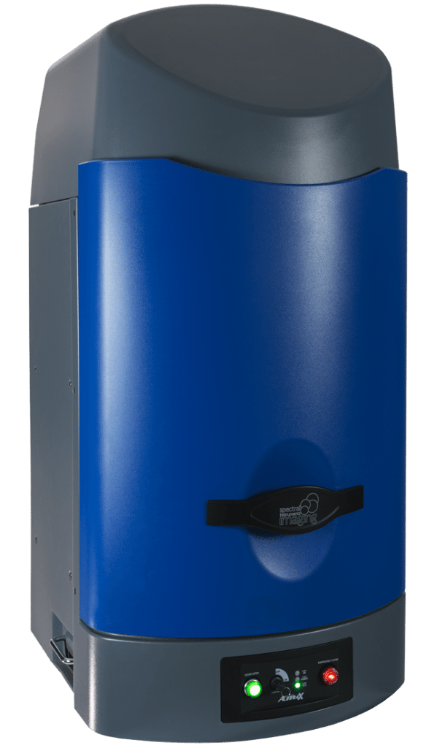
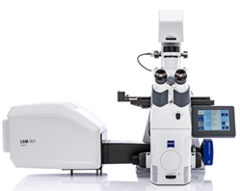
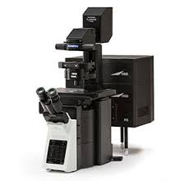
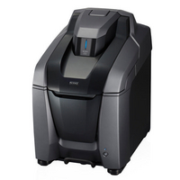
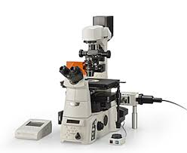

Stem Cell Research Center Imaging Core Instruments
Start
Will you image or perform microdissections?
Does your specimen have a heartbeat?
No
Image
Nikon SMZ1500
Dissection
Room 1402
Fluorescent dissection imaging
0.75x to 11.25x
GFP & RFP filter cubes
Fiber optic light source
Color camera
Yes
Dissect
Is your sample alive in a dish or dead and fixed to a slide?
Spectral Imaging Instruments AMI-HT imager
Vivarium B640
Recharge Rate: $50/hr
Live animal imaging
Fluorescence & Luminescence
Isoflurane for five animals at a time
Scopes without Incubation
Scopes with Incubation
System | Features | Benefits |  | Applications
Zeiss LSM 900 Airyscan 2 Inverted Confocal Room 4401 Recharge Rate: $25/hr | High-powered fluorescent live cell imaging Airyscan 2 & GaAsP-PMTs 2.5x, 10x, 20x, 40x (water or oil), & 63x (oil) 405nm, 488nm, 561nm, & 640nm laser lines UV 385nm, 475nm, 555 nm, 630nm filter cubes Stage top and microscope enclosed incubator AI Sample Finder | Airyscan 2 (super resolution)/GaAsP (confocal) hybrid scanner; AI Sample Finder; Fast acquisition speeds; Large area scanning; Corrects focus drift; Deconvolution; |  | Fluorescence Cohesive Contrast
Olympus FV3000 Laser Scanning Inverted Confocal Room 1402 Recharge Rate: $25/hr | High-powered fluorescent live cell imaging 2x ma-PMTs & 2x GaAsP-PMTs 1.25x, 10x, 20x, & 40x (oil); 60x (oil) on system 1 405nm, 488nm, 561nm, & 640nm laser lines FUW, FBN, & FGW (RBG) filter cubes Tokai-HIT stage top incubator on system 1 Olympus TruSpectral detection | Galvo/resonant hybrid scanner on system 1; Galvo on system 2 Fast acquisition speeds; Large area scanning; Corrects focus drift; Zoom feature; Deconvolution; |  | Fluorescence DIC
Biotek Cytation 5/BioSpa Inverted Widefield Imaging Plate Reader/Incubator Room 4502 | Imaging plate reader with BioSpa for incubation Monochromator and filters for plate reading; 4x, 10x, 20, 40x, & 60x (non-oil) DAPI, GFP, TxRed, RFP, CY5 imaging filter cubes | Imaging plate reader with long term incubation; Holds up to 6 plates; Self-contained unit; Controls room light; Reduces background; |  | Fluorescence Brightfield Digital Phase
Keyence BZX-810 Inverted Widefield Room 2301 & 4502 | Compact benchtop system (scope-in-a-box) 4x, 10x, 20x, 40x, 20x LWD & 40x LWD (4502), 63x (oil;2301) DAPI, GFP, TRITC, TxRed, & Cy5 filter cubes Equipped with Auto Focus Optical sectioning module in 2301 Stage top incubator in 4502 | Self-contained unit; Controls room light; Large area scanning; Reduces background; Many vessel holders |  | Fluorescence Brightfield Phase
Nikon Ti-E Inverted Widefield Room 1402 & 3402 | Basic research microscope 4x, 10x, 20x, 20LWDx (3402), 40x, 60x (oil), & 100x (oil; 1402) DAPI, FITC, TRITC, TxRed, & Cy5 filter cubes Equipped with Perfect Focus System | Many vessel holders; Control focus drift; Reduces background; |  | Fluorescence Brightfield Phase
System | Features | Benefits |  | Applications
Zeiss LSM 900 Airyscan 2 Inverted Confocal Room 4401 Recharge Rate: $25/hr | High-powered fluorescent live cell imaging Airyscan 2 & GaAsP-PMTs 2.5x, 10x, 20x, 40x (water or oil), & 63x (oil) 405nm, 488nm, 561nm, & 640nm laser lines UV 385nm, 475nm, 555 nm, 630nm filter cubes Stage top and microscope enclosed incubator AI Sample Finder | Airyscan 2 (super resolution)/GaAsP (confocal) hybrid scanner; AI Sample Finder; Fast acquisition speeds; Large area scanning; Corrects focus drift; Deconvolution; |  | Fluorescence Cohesive Contrast
Olympus FV3000 Laser Scanning Inverted Confocal Room 1402 Recharge Rate: $25/hr | High-powered fluorescent live cell imaging 2x ma-PMTs & 2x GaAsP-PMTs 1.25x, 10x, 20x, & 40x (oil); 60x (oil) on system 1 405nm, 488nm, 561nm, & 640nm laser lines FUW, FBN, & FGW (RBG) filter cubes Tokai-HIT stage top incubator on system 1 Olympus TruSpectral detection | Galvo/resonant hybrid scanner on system 1; Fast acquisition speeds; Large area scanning; Corrects focus drift; Zoom feature; Deconvolution; |  | Fluorescence DIC
Biotek Cytation 5/BioSpa Inverted Widefield Imaging Plate Reader/Incubator Room 4502 | Imaging plate reader with BioSpa for incubation Monochromator and filters for plate reading; 4x, 10x, 20, 40x, & 60x (non-oil) DAPI, GFP, TxRed, RFP, CY5 imaging filter cubes | Imaging plate reader with long term incubation; Holds up to 6 plates; Self-contained unit; Controls room light; Reduces background; |  | Fluorescence Brightfield Digital Phase
Contact Information
Allia Fawaz, M.S.
SCRC Core Microscope Imaging Manager
Gross Hall Building Manager
Fawaza@uci.edu

Slide 2
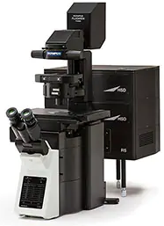
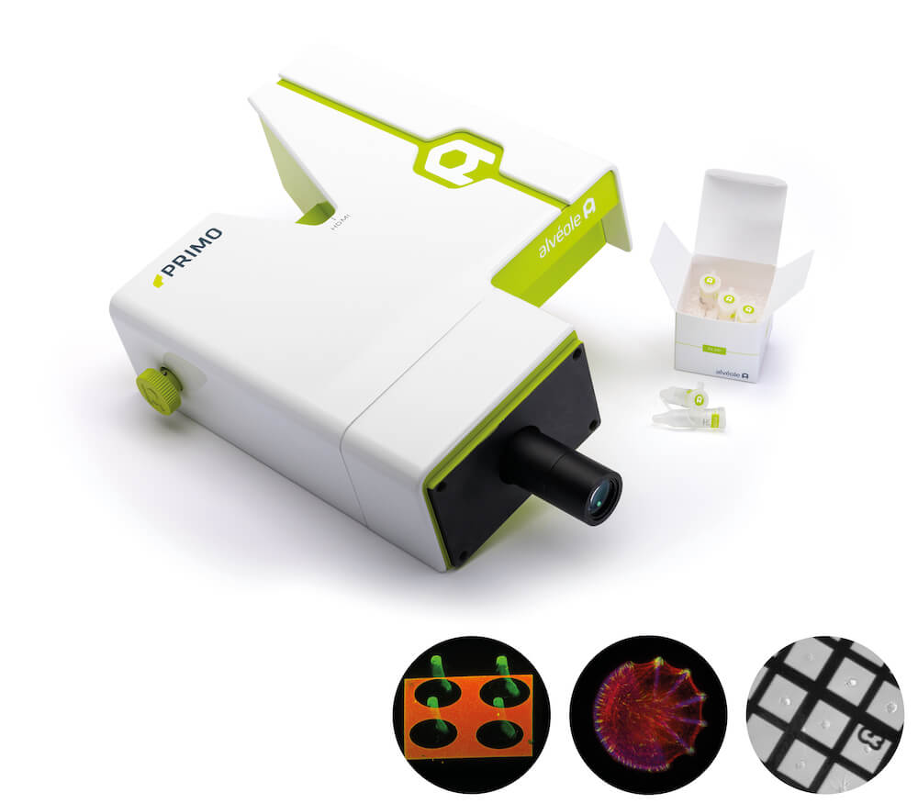
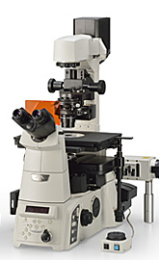
Stem Cell Research Center Imaging Core Instruments
Microscope Imaging Systems | Features | Benefits | System | Applications
Zeiss LSM 900 Airyscan 2 /Confocal Inverted Confocal Room 4401 Recharge Rate: $25/hr | High-powered fluorescent live cell imaging Airyscan 2 & GaAsP-PMTs 2.5x, 10x, 20x, 40x (water or oil), & 63x (oil) 405nm, 488nm, 561nm, & 640nm laser lines UV 385nm, 475nm, 555 nm, 630nm filter cubes Stage top and microscope enclosed incubator AI Sample Finder | Airyscan 2 (super resolution)/GaAsP (confocal) hybrid scanner; AI Sample Finder; Fast acquisition speeds; Large area scanning; Corrects focus drift; Deconvolution; |  | Fluorescence Cohesive Contrast
Olympus FV3000 Laser Scanning Confocal Microscope Inverted Confocal Room 1402 Recharge Rate: $25/hr | High-powered fluorescent live cell imaging 2x ma-PMTs & 2x GaAsP-PMTs 1.25x, 10x, 20x, & 40x (oil); 60x (oil) on system 1 405nm, 488nm, 561nm, & 640nm laser lines FUW, FBN, & FGW (RBG) filter cubes Tokai-HIT stage top incubator on system 1 Olympus TruSpectral detection | Galvo/resonant hybrid scanner; Fast acquisition speeds; Large area scanning; Corrects focus drift; Zoom feature; Deconvolution; |  | Fluorescence DIC
Biotek Cytation 5/BioSpa Inverted Widefield Imaging Plate Reader/Incubator Room 4502 | Imaging plate reader with BioSpa for incubation Monochromator and filters for plate reading; 4x, 10x, 20, 40x, & 60x (non-oil) DAPI, GFP, TxRed, RFP, CY5 imaging filter cubes | Imaging plate reader with long term incubation; Holds up to 6 plates; Self-contained unit; Controls room light; Reduces background; |  | Fluorescence Brightfield Digital Phase
Keyence BZX-810 Inverted Widefield Room 2301 & 4502 | Compact benchtop system (scope-in-a-box) 4x, 10x, 20x, 40x, 20x LWD & 40x LWD (4502), 63x (oil;2301) DAPI, GFP, TRITC, TxRed, & Cy5 filter cubes Equipped with Auto Focus Optical sectioning module in 2301 Stage top incubator in 4502 | Self-contained unit; Controls room light; Large area scanning; Reduces background; Many vessel holders |  | Fluorescence Brightfield Phase
Nikon Ti-E Inverted Widefield Room 1402 & 3402 | Basic research microscope 4x, 10x, 20x, 20LWDx (3402), 40x, 60x (oil), & 100x (oil; 1402) DAPI, FITC, TRITC, TxRed, & Cy5 filter cubes Equipped with Perfect Focus System | Many vessel holders; Control focus drift; Reduces background; |  | Fluorescence Brightfield Phase
Other Imaging Systems | Features & Benefits
Spectral Imaging Instruments AMI-HT imager Room: Vivarium B640 Recharge Rate: $50/hr | Live animal imaging Fluorescence & Luminescence Isoflurane for five animals at a time
PRIMO Inverted Widefield Room 4207 | Micropatterning, microfabrication, and hydrogel formation
Nikon SMZ1500 Dissection Room 1402 | Fluorescent dissection imaging 0.75x to 11.25x GFP & RFP filter cubes Fiber optic light source Color camera
Contact Information
Allia Fawaz, M.S. FawazA@uci.edu (949) 824-0430
SCRC Core Microscope Imaging Manager
Gross Hall Building Manager

